Slide 1
MINI - PROJECT
Name – Kavya Bhuva
Devanshi Sojitra
Er no. – 92300527006
92300527005
Class – BCA 5(D)
Submitted to – Dipak Sir

Slide 2
SCHOOL MANAGEMENT SYSTEM USING PYTHON

Slide 3
INTRODUCTION
This Python program is a console-based School Management System designed to help manage student records efficiently using CSV file storage. It provides functionality to add, view, update, delete, search, sort, and count student data, along with the ability to export records to a text file. The system captures details such as student ID, name, age, grade, address, phone number, email, and guardian's name. It includes basic validation for age and grade to ensure data integrity. Designed for simplicity and ease of use, this application is ideal for small educational institutions or individual record-keeping purposes.

Slide 4
FEATURES
Here are the features of your School Management System code,
Add Student – Allows adding new student records with input validation for age and grade.
View Students – Displays all student records stored in the CSV file.
Delete Student – Removes a student record based on the provided student ID.
Update Student – Enables updating specific details of a student using their ID.
Search Student – Searches for a student by name or ID and displays matching results.
Sort Students by Grade – Sorts and displays students in order of their grade.
Export to Text File – Exports all student records into a readable .txt file.
Student Count – Displays the total number of student records in the system.

Slide 5
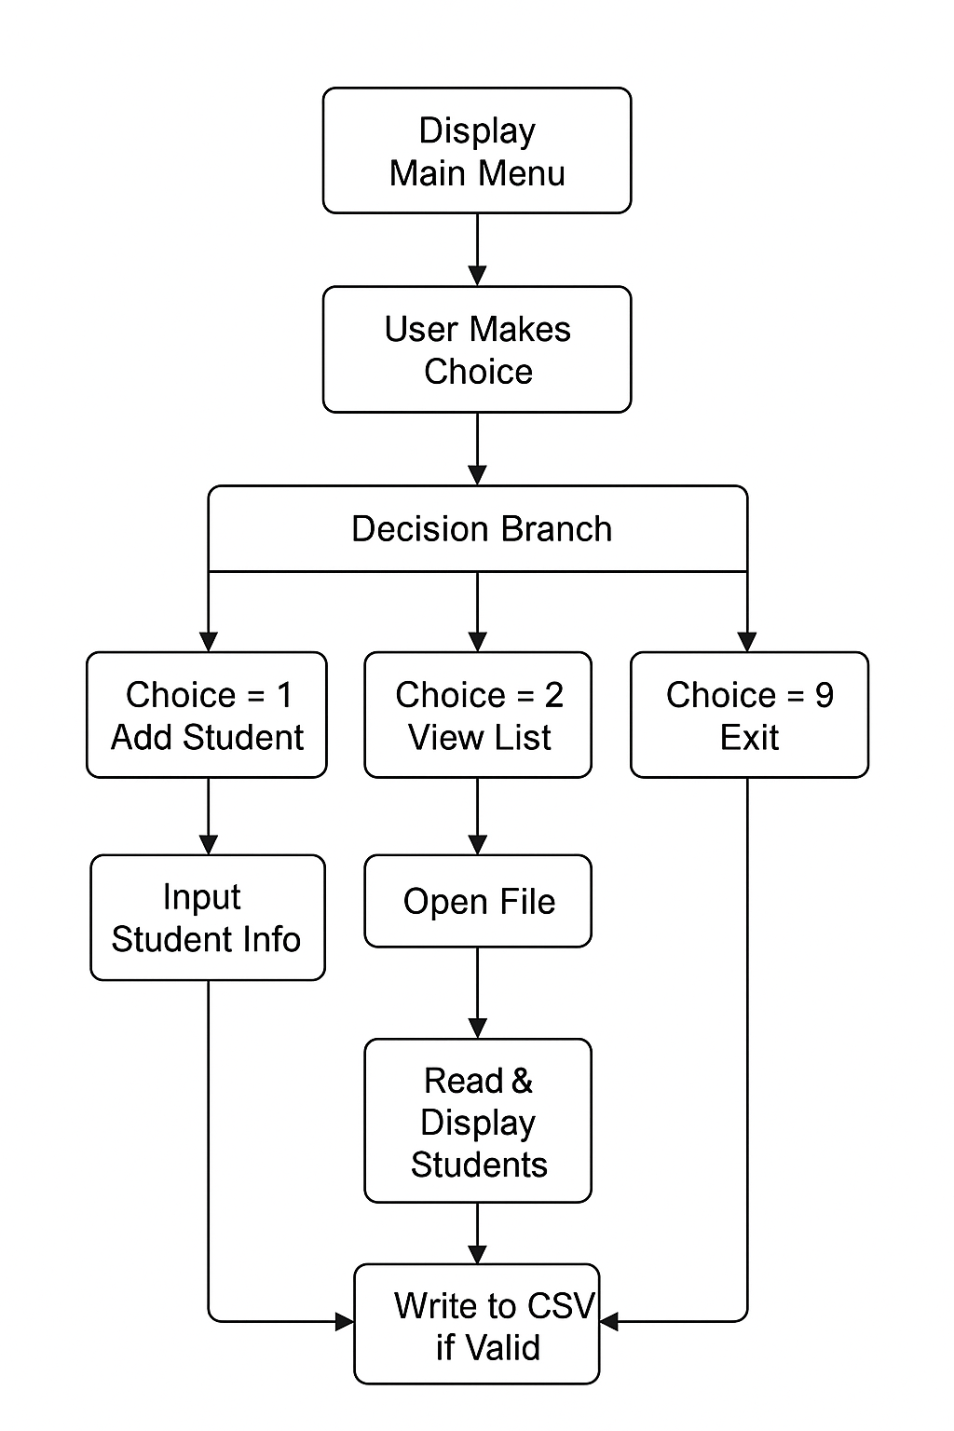
Activity Diagram

Slide 6
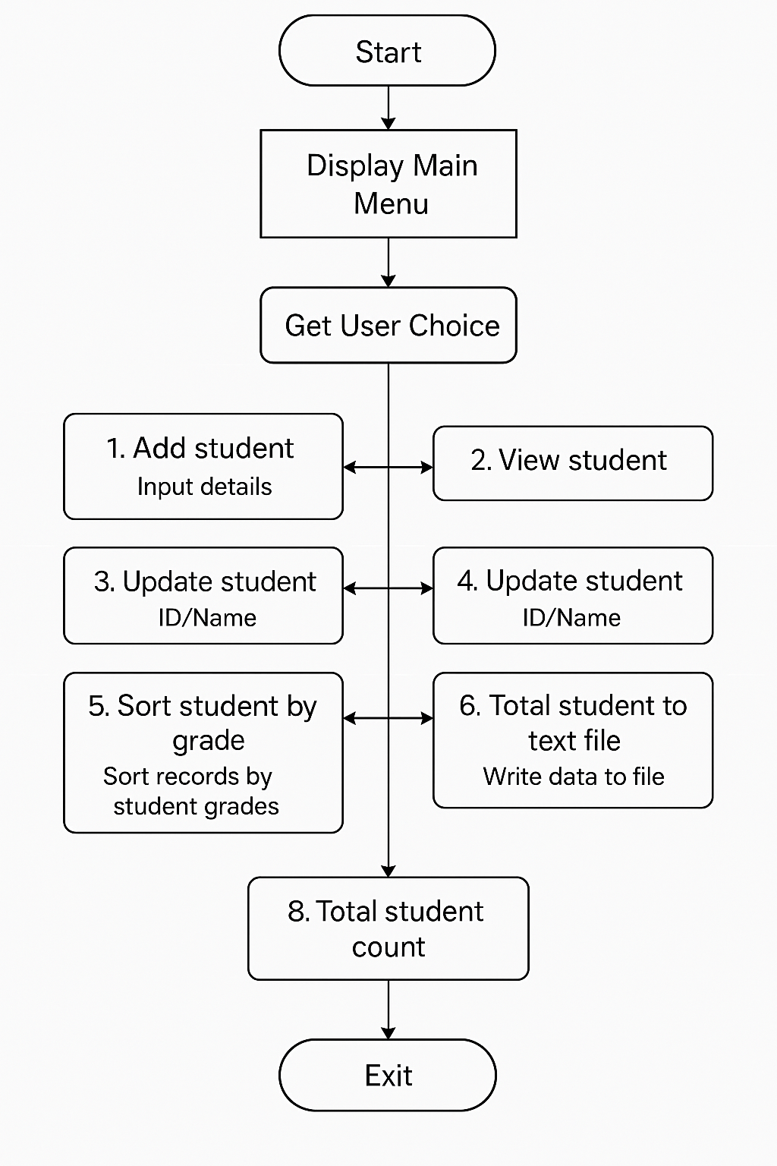
Diagram [FLOWCHAT]

Slide 7
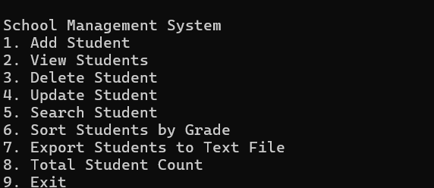
MAIN MENU

Slide 8
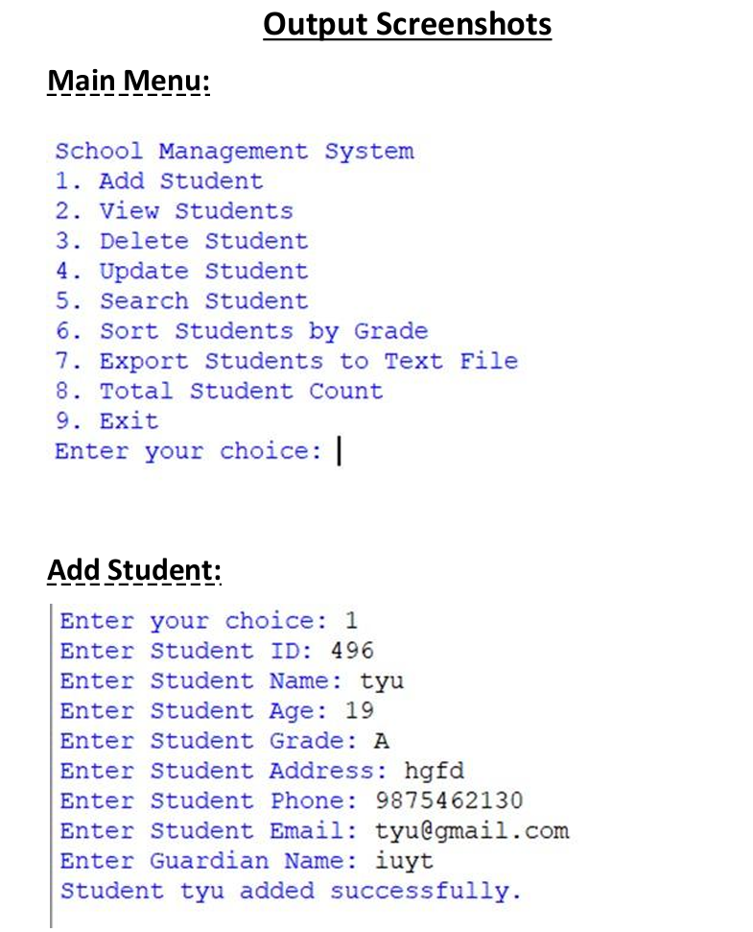
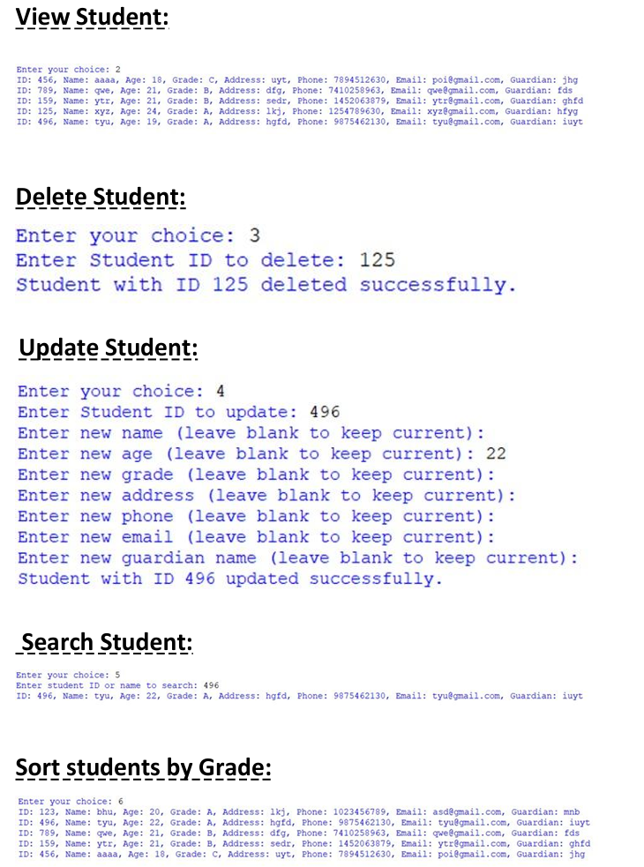
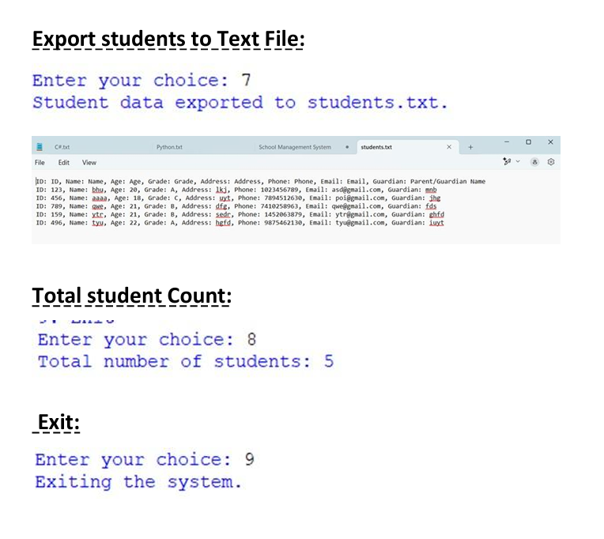

Slide 9
OBJECTIVES
Student Data Management – To efficiently manage student records including adding, updating, viewing, deleting, and searching.
Persistent Storage – To store all student data in a CSV file for long-term and reliable access.
User-Friendly Interface – To provide a simple, menu-driven command-line interface for interacting with the system.
Data Validation – To ensure integrity by validating age and grade inputs before storing student data.
Data Sorting and Organization – To allow sorting of student records by grade for better academic insights.
Data Export – To provide an option to export student data into a readable text file for reporting or printing.
Scalability and Maintenance – To structure the code in a modular and maintainable way for future enhancements.
Quick Student Lookup – To support fast and flexible searching of student records using ID or name.
Summary Information – To display the total number of students as a quick statistical overview..

Slide 10
CONCLUSION
This School Management System is a simple yet functional console-based application that enables efficient management of student records. It allows users to perform key operations such as adding, viewing, updating, deleting, and searching student data stored in a CSV file. The system also supports data validation, sorting by grades, exporting records to a text file, and counting total students. Designed with modularity and file handling in mind, the application provides a user-friendly interface for school administrators, ensuring data accuracy and easy accessibility. This project serves as a practical solution for basic student data management and can be further enhanced with a graphical interface or database integration in the future.

Slide 11
Thank you!!!!!

